Slide 1
Analysis of Video Game Sales
Based of regional market correlations and historical publisher performance

Slide 2
Primary Objective
Identify if there is a positive correlation between the north American gaming market and other major foreign gaming markets.
Identify top performing publishers for each individual market for future contract recommendations.

Slide 3
Data Recap
The data was sourced from Kaggle.
Video Game Sales | Kaggle
It had 11 fields varying from Publisher, to Platform, to Global Sales, etc.
It had 16,598 records of video games, all published between 1980 – 2020.
This dataset only included games that sold more than 100,000 copies.

Slide 4
Our Hypothesis
H1: There is a positive correlation between north American sales and European sales.
H2: There is a positive correlation between north American sales and Japanese sales.

Slide 5
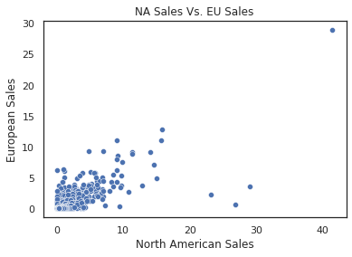
H1
P Value = 0.77
We can expect a strong correlation between these two variables.

Slide 6
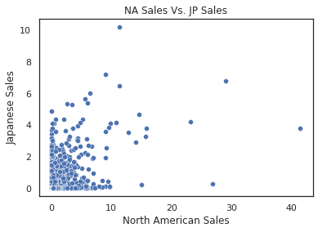
H2
P Value = 0.45
We can expect a moderate correlation between these two variables.

Slide 7
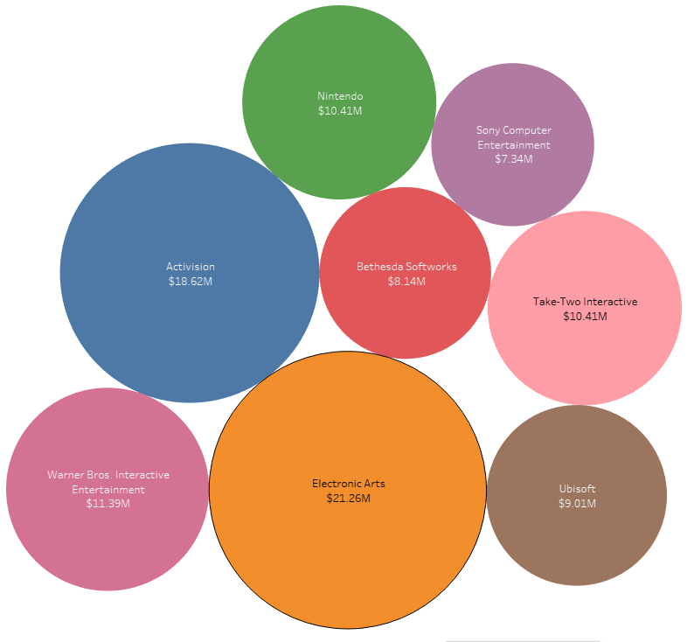
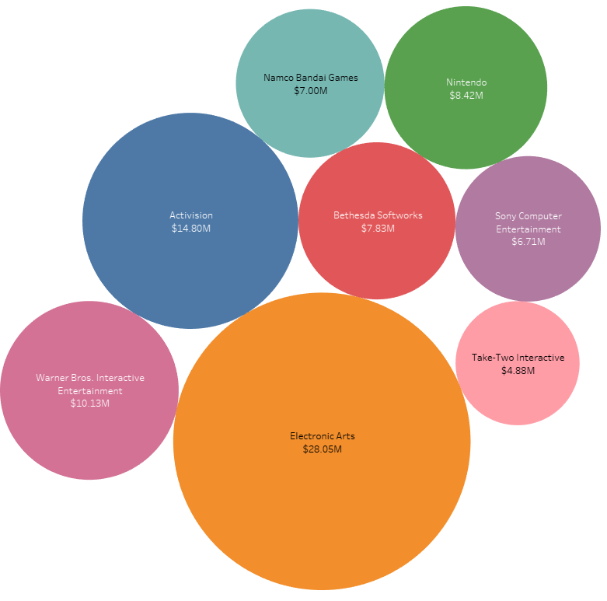
Top performing publishers NA and EU
NA = 37% of global market
Electronic Arts
Activision
Warner Bros.
Take-Two Interactive
Nintendo
Ubisoft
Bethesda Softworks
Sony
EU = 37% of global market
Electronic Arts
Activision
Warner Bros.
Nintendo
Bethesda Softworks
Namco Bandai Games
Sony
Take-Two Interactive

Slide 8
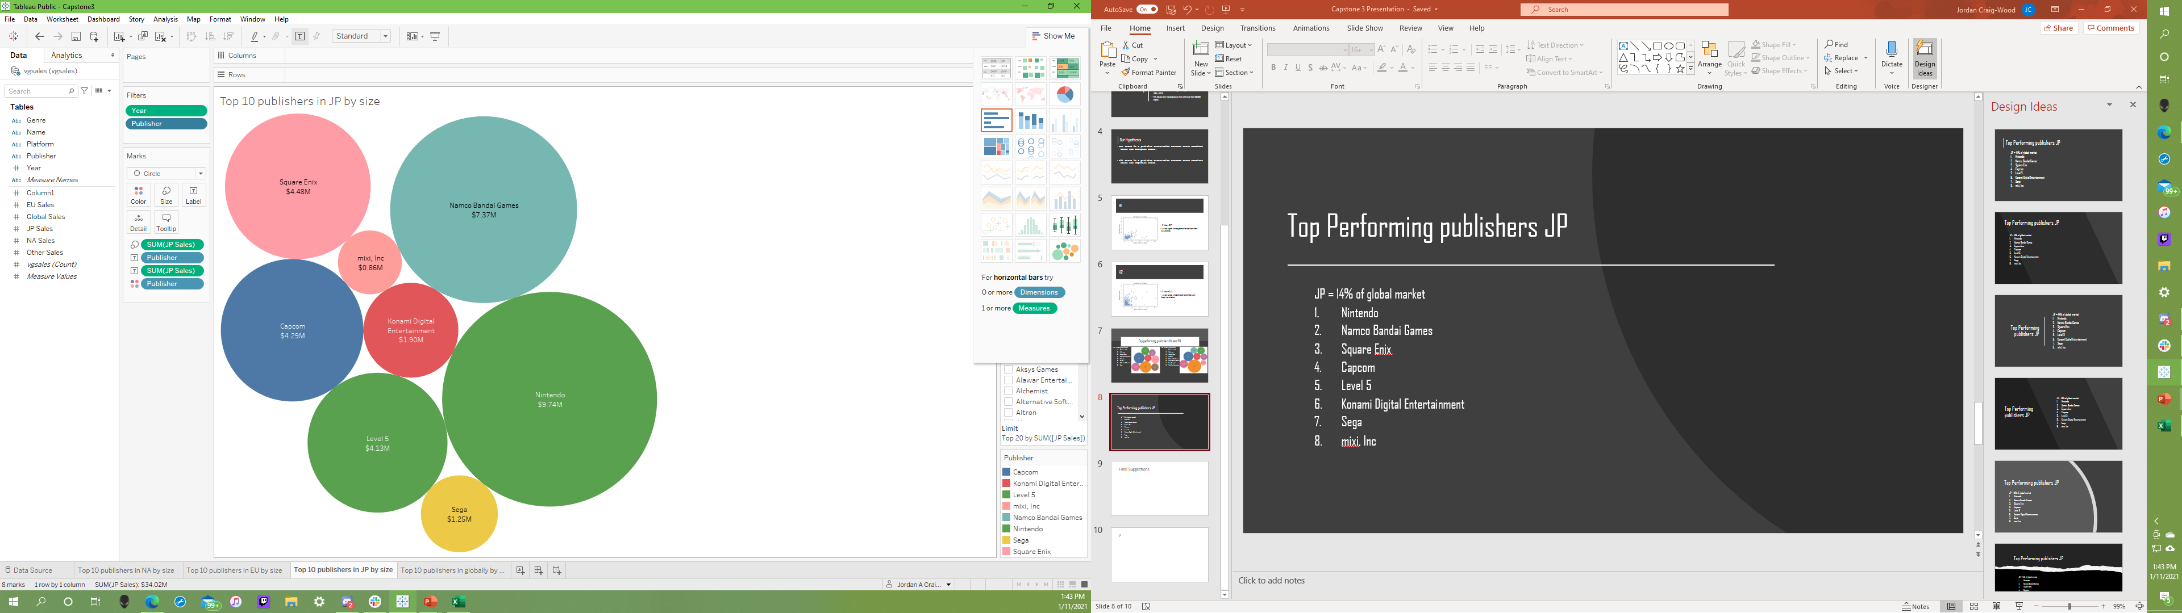
Top Performing publishers JP
JP = 14% of global market
Nintendo
Namco Bandai Games
Square Enix
Capcom
Level 5
Konami Digital Entertainment
Sega
mixi, Inc

Slide 9
Final Suggestions
With the NA and EU markets having such a strong correlation, and both being much larger than the JP market, there is higher potential for overall sales by trying to appeal to these markets.
These correlations are likely due to cultural similarities. You can run similar marketing campaigns, which can help reduce marketing costs. Both NA and EU markets are predominantly English speaking.
Based off this analysis, my final recommendation is to focus on the NA and EU markets for new contracts, ideally seeking contracts with with Electronic Arts, Activision Blizzard, and Warner Bros. Interactive Entertainment.

Slide 10
?

